Slide 1
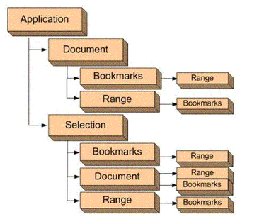
急急急
LLLL
jjjjjjjjjjjjjjjjjjjjj

